Slide 1

CSS Bootstrap

Slide 2
Jak se napojuje framework?
Dříve externí soubory (stažení a připojení stylesheetu)
Dnes propojení skrz odkaz:
<link href="https://cdn.jsdelivr.net/npm/bootstrap@5.3.2/dist/css/bootstrap.min.css" rel="stylesheet" integrity="sha384-T3c6CoIi6uLrA9TneNEoa7RxnatzjcDSCmG1MXxSR1GAsXEV/Dwwykc2MPK8M2HN" crossorigin="anonymous">
Lze i skrz JS script
<script src="https://cdn.jsdelivr.net/npm/bootstrap@5.3.2/dist/js/bootstrap.bundle.min.js" integrity="sha384-C6RzsynM9kWDrMNeT87bh95OGNyZPhcTNXj1NW7RuBCsyN/o0jlpcV8Qyq46cDfL" crossorigin="anonymous"></script>

Slide 3
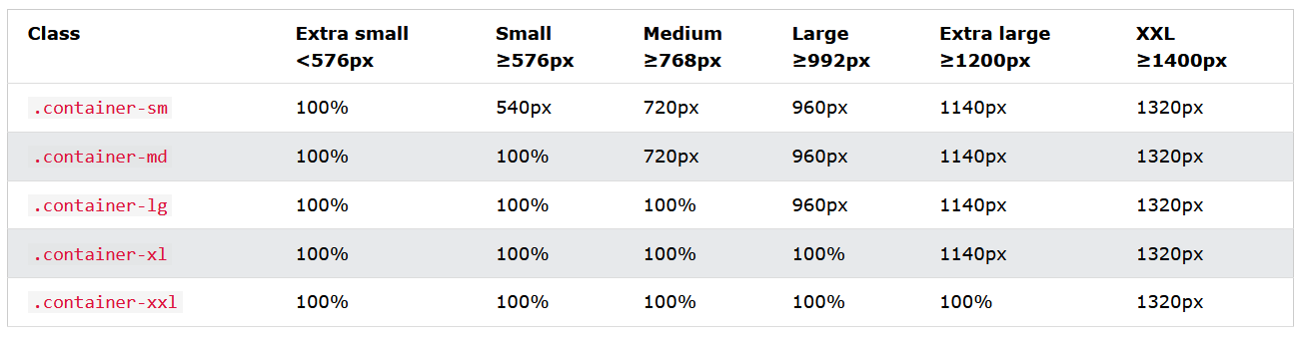
Container
The .container class provides a responsive fixed width container
The .container-fluid class provides a full width container, spanning the entire width of the viewport

Slide 4
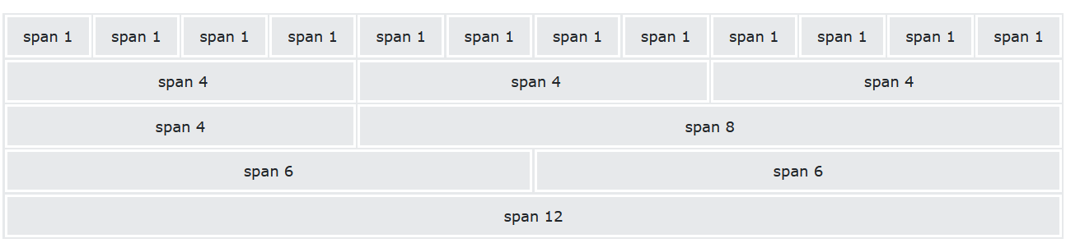
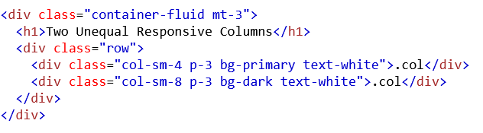
Grid
Až 12 sloupců napříč stránkou

Slide 5
Margin a Padding
Where property is one of:
m - for classes that set margin
p - for classes that set padding
Where sides is one of:
t - for classes that set margin-top or padding-top
b - for classes that set margin-bottom or padding-bottom
l - for classes that set margin-left or padding-left
r - for classes that set margin-right or padding-right
x - for classes that set both *-left and *-right
y - for classes that set both *-top and *-bottom
blank - for classes that set a margin or padding on all 4 sides of the element
Where size is one of:
0 - for classes that eliminate the margin or padding by setting it to 0
1 - (by default) for classes that set the margin or padding to $spacer * .25
2 - (by default) for classes that set the margin or padding to $spacer * .5
3 - (by default) for classes that set the margin or padding to $spacer
4 - (by default) for classes that set the margin or padding to $spacer * 1.5
5 - (by default) for classes that set the margin or padding to $spacer * 3
auto - for classes that set the margin to auto

Slide 6

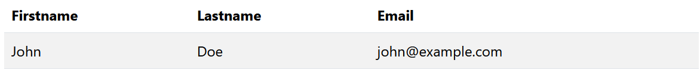
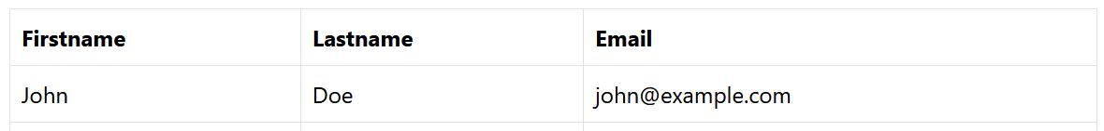
Table
.table
.table-striped
.table-bordered

Slide 7

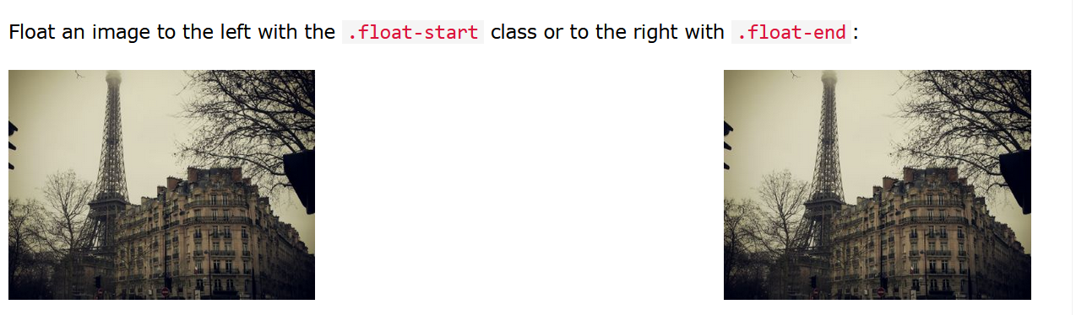
Img
.rounded
.rounded-circle
.img-thumbnail
.float-start
.float-end
.img-fluid

Slide 8
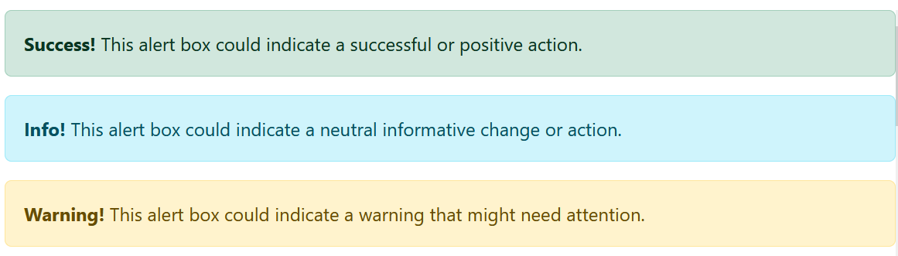
Alert
.alert
.alert-success, .alert-info, .alert-warning, .alert-danger, .alert-primary, .alert-secondary, .alert-light or .alert-dark

Slide 9


Buttons
.btn
.btn-sm; .btn-lg

Slide 10

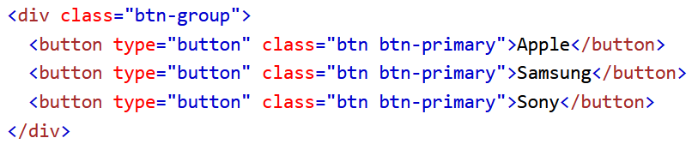

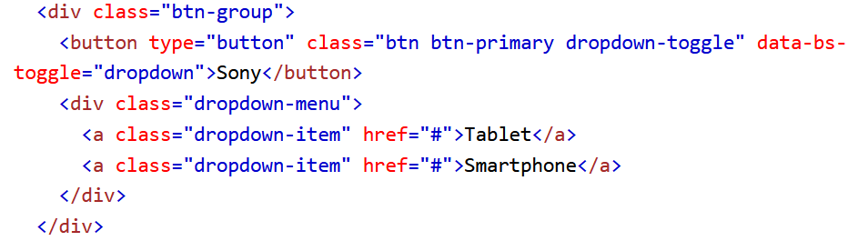
Button Groups
.btn-group-vertical

Slide 11
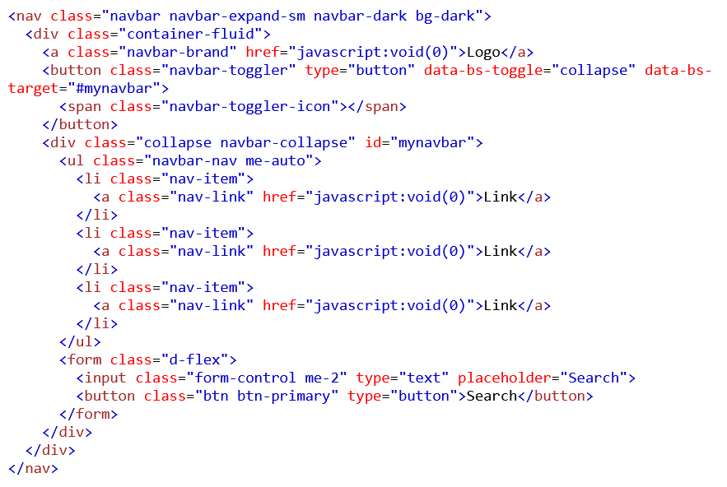
NavBar

Slide 12
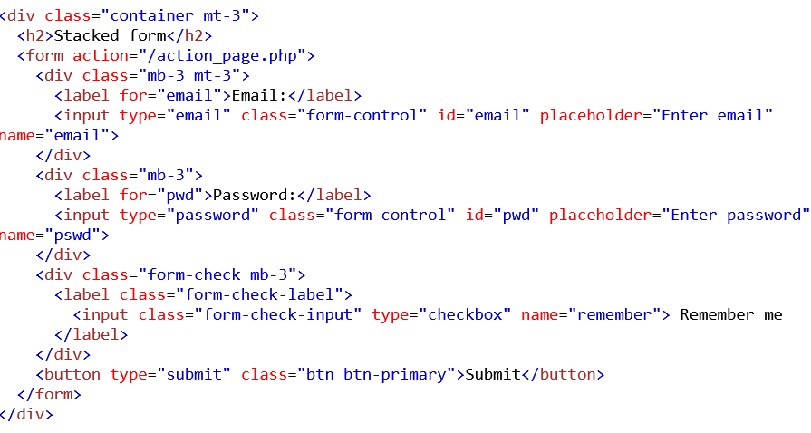
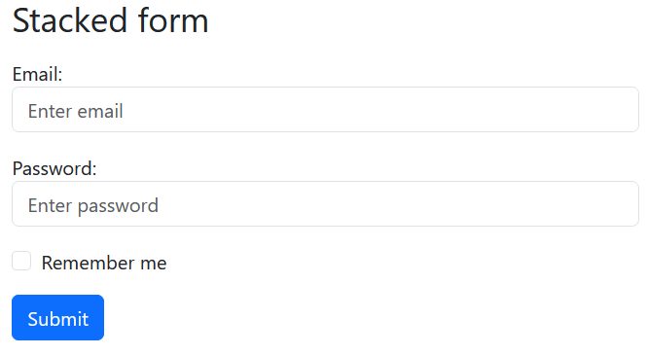
Form

